Slide 1
Module -1 (Algorithm development)
Prepared by
Dr.S.Jenicka
Associate Professor Grade 1
SCOPE-Analytics
VIT Vellore

Slide 2

Analysis of recursive algorithms – Substitution method
Decide on a parameter (or parameters) indicating an input’s size.
Identify the algorithm’s basic operation.
Check whether the number of times the basic operation is executed can vary on different inputs of the same size. If it can, the worst-case, average-case, and best-case efficiencies must be investigated separately.
Set up a recurrence relation, with an appropriate initial condition, for the number of times the basic operation is executed.
Solve the recurrence or, at least, ascertain the order of growth of its solution.

Slide 3
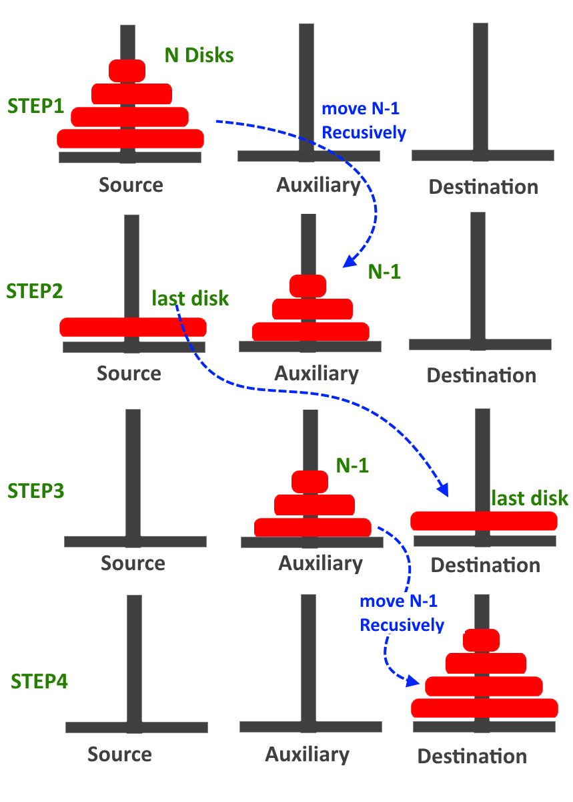
Tower of Hanoi problem- recursive algorithm
The goal is to move all disks from source to destination. The rules are:
You may move only one disk at a time.
No disk may ever rest atop a smaller disk.
Steps:
Transform (n-1) disks from Source to auxiliary pole.
Move the nth disk from source to destination pole
Move (n-1) disks from auxiliary to destination pole

Slide 4
-Contd
Moving three disks:
1. Move 2 disks from Source to
auxiliary
2. Move 1 disk from Source to
destination
3. Move 2 disks from auxiliary to
destination

Slide 5
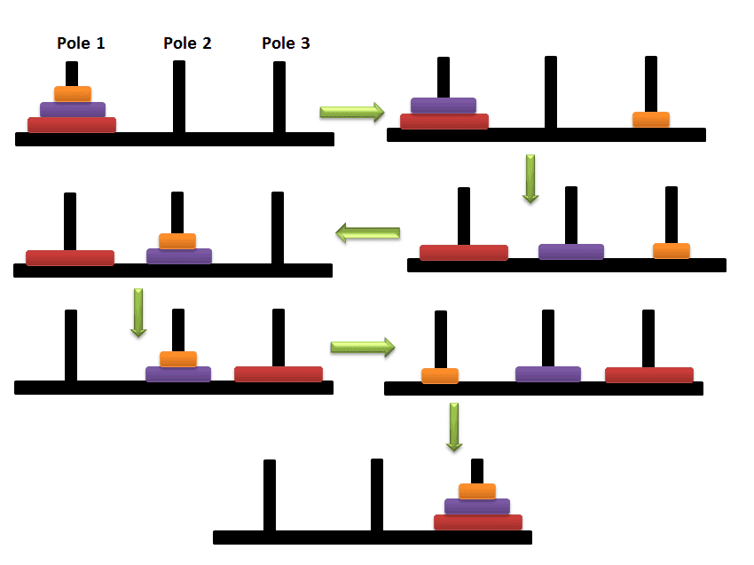
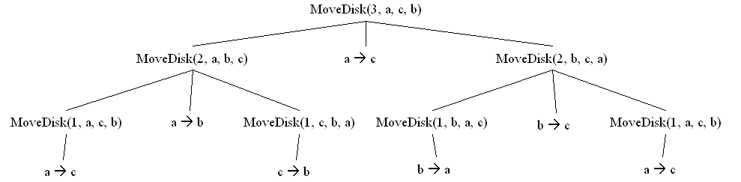

Tracing the algorithm with recursion tree for moving three disks
Pole 1-Source(a), Pole 2-auxiliary(b), Pole 3-Destination(c)

Slide 6
Algorithm
Source
Auxiliary
Algorithm Tower(numdisks, A,C,B)
if (numdisks=1)
print ‘Move disk from A to C’
else
Tower(numdisks-1, A,B,C)
Print ‘ Move disk from A to C’
Tower(numdisks-1, B,C,A)
Where A-Source, B-Auxiliary and C- destination
Destination
Move ‘numdisks-1’ from Source to Auxiliary
Move 1 disk from Source to Destination
Move ‘numdisks-1’ from Auxiliary to Destination

Slide 7
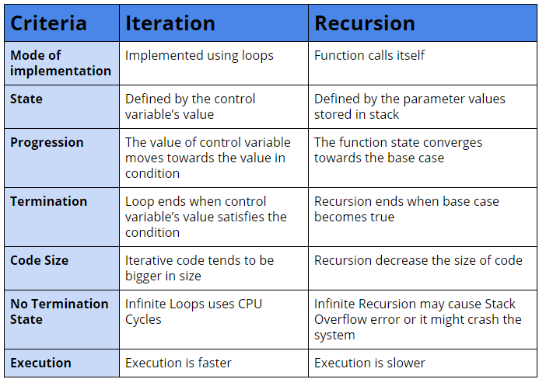

Difference between iteration and recursion

Slide 8
Space complexity
Space complexity indicates how much storage space an algorithm needs.

Slide 9
Examples- Space complexity (S(P))
Sum(int a, int b, int c)
{
return(a+b+c)
}
Integer requires 2 bytes (1 word). Hence for a, b and c
S(P)=3
int findSum(int a[],int n)
{
sum=0;
for(i=1;i<n;i++)
sum=sum+a[i];
return sum
}
i, sum, n require 1 word each
a[] requires n words
S(P)=n+3

Slide 10
Algorithm time efficiency or time complexity
Running time of an algorithm on a particular input is the number of primitive operations or steps executed. It is done in two steps.
Identify the basic operation
Find how many times it is executed
T(n)=C_{op} C(n) where ‘n’ is the input size
C_{op} is the execution time taken by basic operation
C(n) is the number of times it is executed.

Slide 11
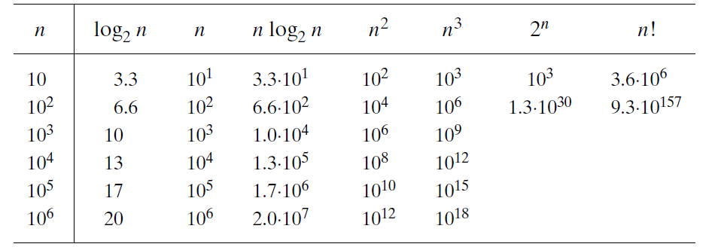
Why Order of growth?
We want the algorithms to work faster for all values of n as real time algorithms work with large values of n. It is desirable to find the growth of T(n) with increasing values of n called as order of growth. The efficiency analysis framework ignores multiplicative constants and concentrates on the count’s (C(n)) order of growth to within a constant multiple for large-size inputs.

Slide 12
Why best, worst and average case time complexities?
In an algorithm, check whether the number of times the basic operation is executed can vary on different inputs of the same size. If it can, the worst-case, average-case, and best-case efficiencies must be investigated separately.
For example in linear search problem, the number of comparisons made is the basic operation. If the key is found in the first place itself, then
best case T(n)=1
or else if it found in the last position, then
worst case T(n)=n
where n is the number of elements in the list. Average number of comparisons made is n/2, so
average case T(n)=n/2

Slide 13
Definitions of best case, worst case and average case time complexity
Worst case : The efficiency of an algorithm for input size ‘n’ which takes longest time to execute among all possible inputs is called worst case time efficiency.
Best case: The efficiency of an algorithm for input size ‘n’ which takes least time to execute among all possible inputs is called best case time efficiency.
Average case: The average case efficiency of an algorithm for input size ‘n’ is equal to the average number of times the basic operation is executed among all possible inputs.

Slide 14
Asymptotic notations
The efficiency analysis framework concentrates on the order of growth of an algorithm’s basic operation count as the principal indicator of the algorithm’s efficiency. To compare and rank such orders of growth, computer scientists use three notations: O (big oh), (big omega), and (big theta)
O- Big Oh - worst case
Ω -Big Omega- best case
Θ – Big Theta –average case

Slide 15
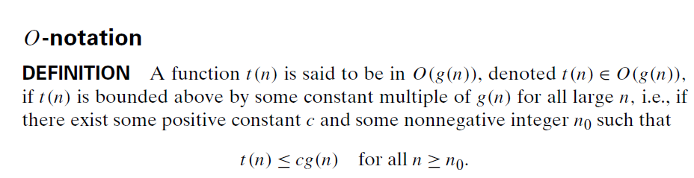
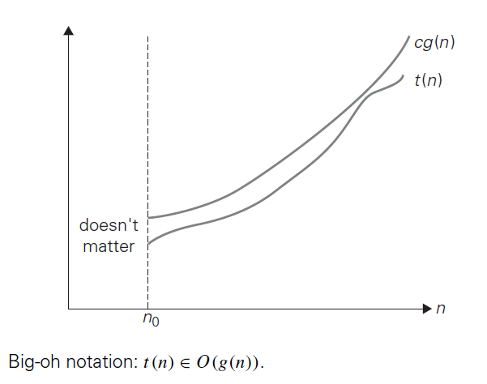
Big Oh
T(n)=C_{op} C(n)
As g(n) in t(n)<=g(n), is the number of times the basic operation is executed (same as C(n)), it is a positive constant.

Slide 16
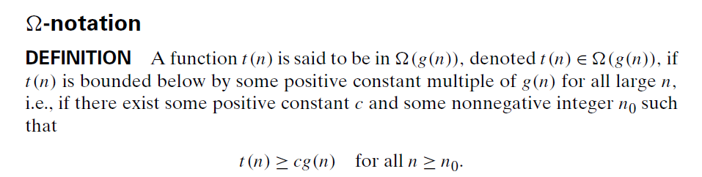
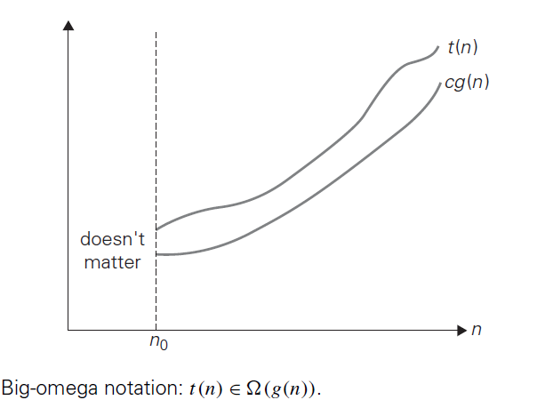
Big Omega

Slide 17
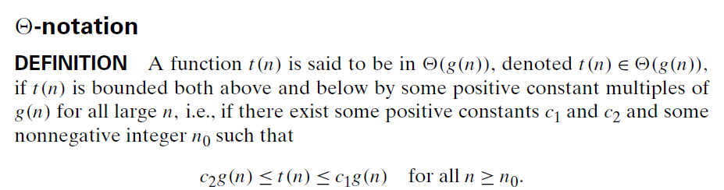
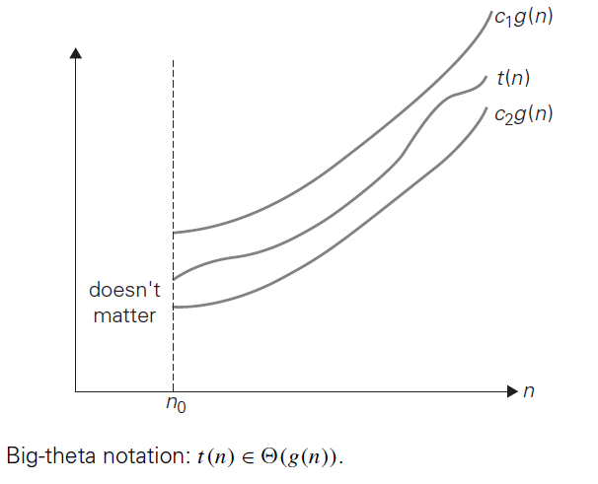
Big Theta

Slide 18
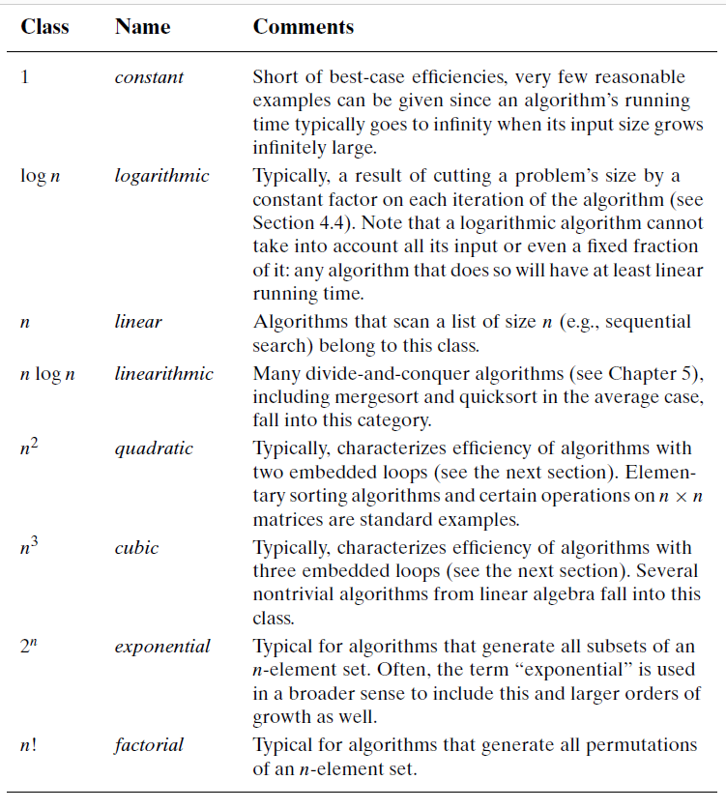
Basic Asymptotic efficiency classes

Slide 19
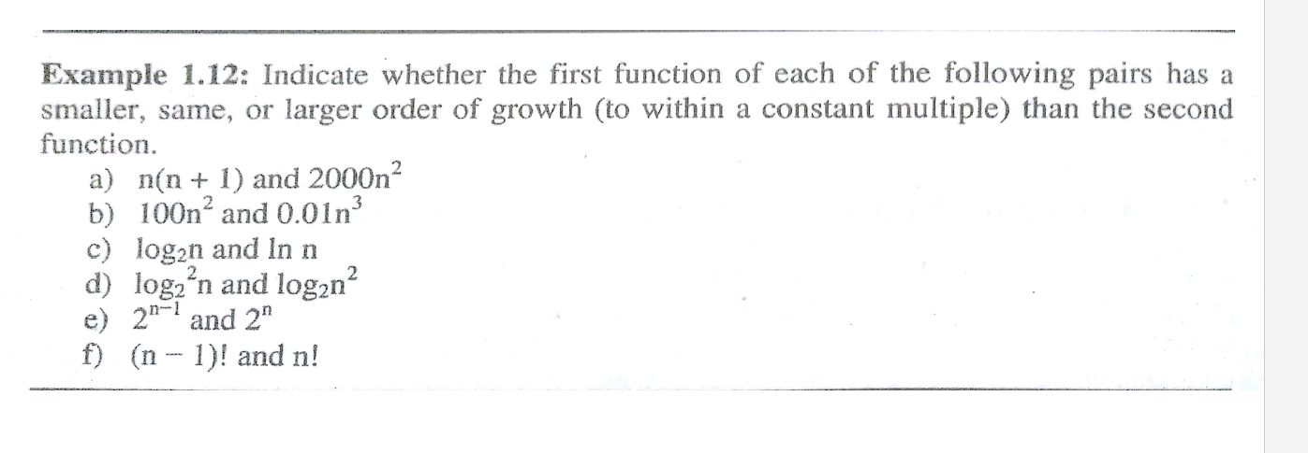
Examples

